Slide 1
Microbiome Signatures of Cancer: Fact or Artifact? Navigating a Current Controversy in Microbiome Sciences
Anthony Fodor
afodor@charlotte.edu
November 21, 2024

Slide 2
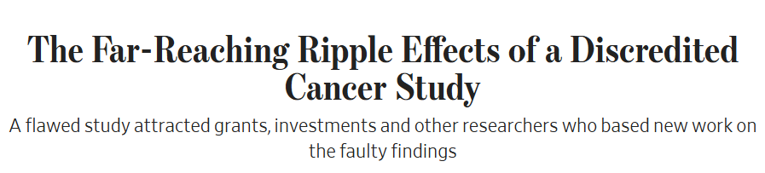
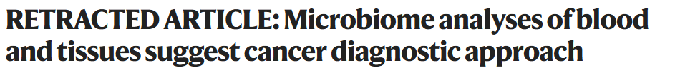
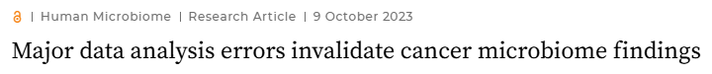

(Wall Street journal)
The article describes an initial Knight lab analysis done in this paper which argues
that there is a microbial signature in cancer.
The retracted paper is here: https://www.nature.com/articles/s41586-020-2095-1
The paper was retracted mostly because of an analysis done here https://journals.asm.org/doi/10.1128/mbio.01607-23
But the original authors responded that their first analysis was largely correct here: https://www.nature.com/articles/s41388-024-02974-w

Slide 3

The 2020 retracted paper. >900 citations. ~$20 million of venture (according to WSJ)

Slide 4
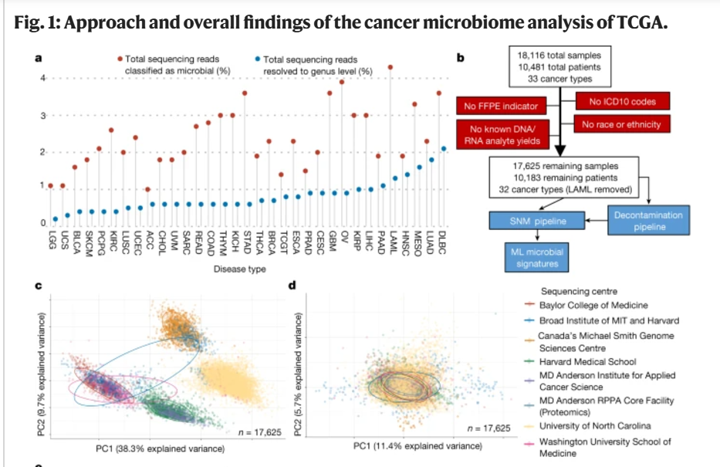

Slide 5
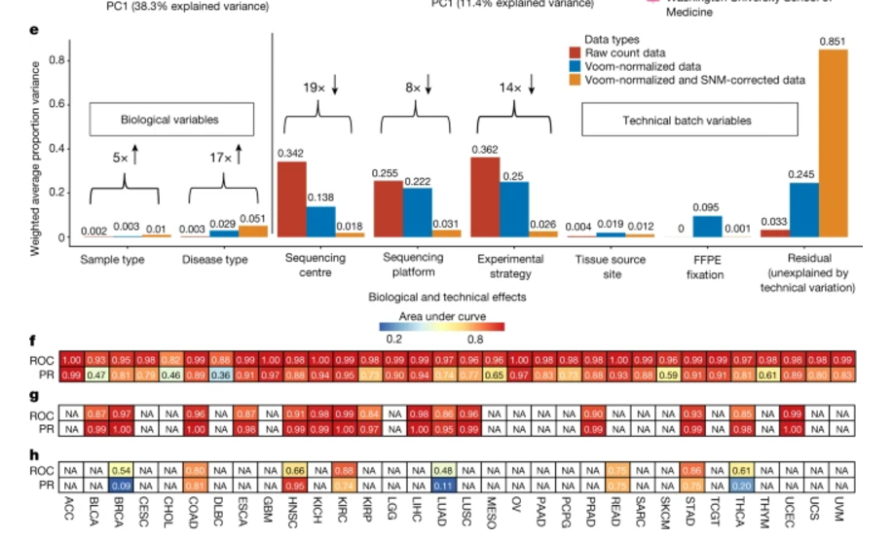
Between tumor
types
Between tumor
And normal

Slide 6
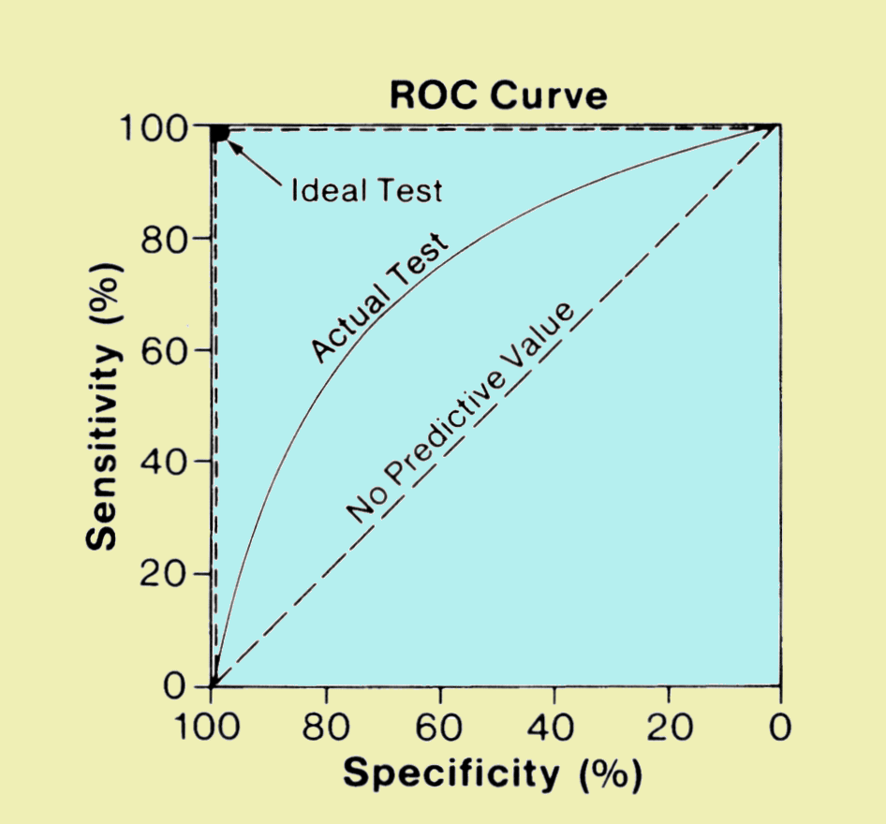
Much of the data in all 3 papers is reported as a result of ROC curves…
Is a sample case or control?
Whole-genome metagenome sequencing
on samples with known disease status
Training set
Test set
Find features
(taxa, genes)
that predict status
Build statistical model
Make predictions on test set
Image: http://www.sprawls.org/ppmi2/IMGCHAR/1IMCHAR12.gif
An area under the curve (AUC) of 100 means a perfect classifier
An AUC of 50 is as good as guessing at random

Slide 7
I think this design is inherently flawed:
Different centers
Batch correction algorithm
Machine learning on all samples
as if they came from the same study
If the batch correction algorithm fails to perfectly compensate for signal from different centers,
and different centers have different kinds of cancer, the machine learning algorithm will
produce artifactual results.
(this is presumably (?) what happened in the original paper)
Using different batch correction algorithms does not really fix this problem
(a major problem with the arguments used in the rebuttal paper!)

Slide 8
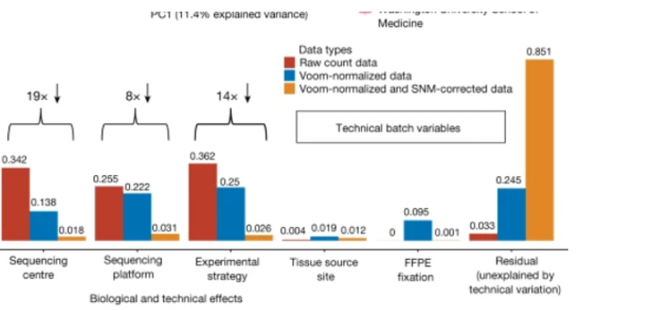
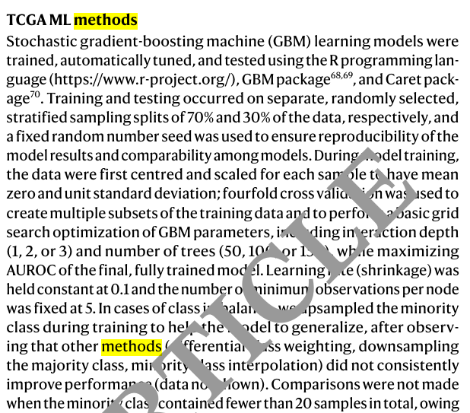
Even after “correction there is still some residual variation associated with sequencing center.
If sequencing center is associated with caner type, that will be more than enough for a
machine learning algorithm to discover, especially one as “flexible” or “tunable” as
Stochastic-gradient boosting machine learning…

Slide 9
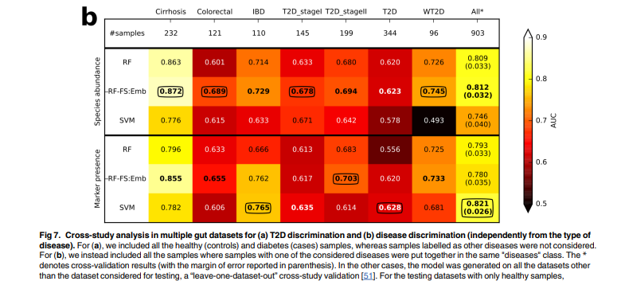
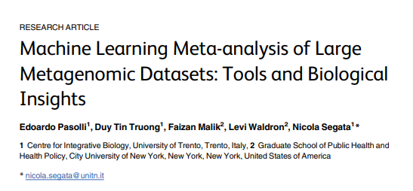
Alternative #1: Leave one study out machine learning approach
Train on all studies but 1 and then test the machine learning model on the left out study
Note that cases and controls have to be in the same study.
You can’t use this approach when cases and controls are from different studies.
Probably when cases and controls are from different studies, you should not attempt a classification analysis!

Slide 10
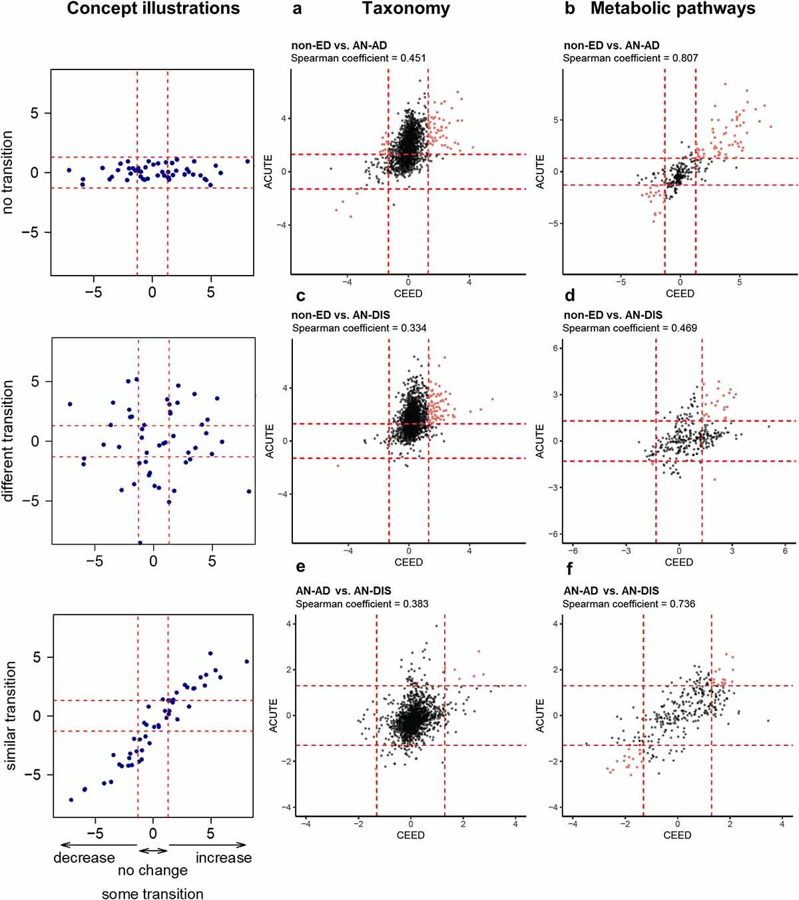
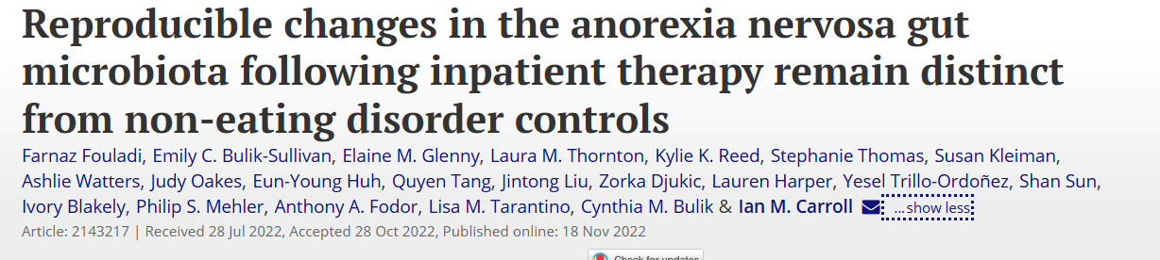
Alternative #2: P-value vs. p-value plots
Perform inference within each study and compare the results…

Slide 11
There are 2 main criticisms in Gihawi et al
Most of the reads that the 1st paper said were microbial are not really microbial
The normalization completely confounds the machine learning results

Slide 12
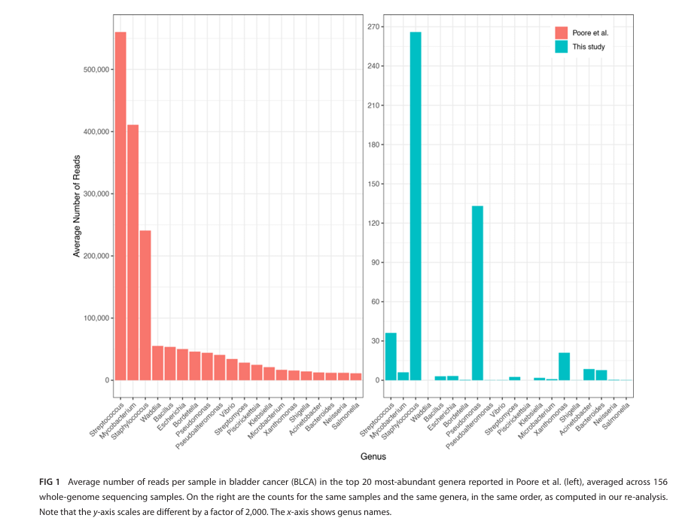
Most of the reads that the 1st paper said were microbial are not really microbial
But that criticism feels minor compared to…

Slide 13
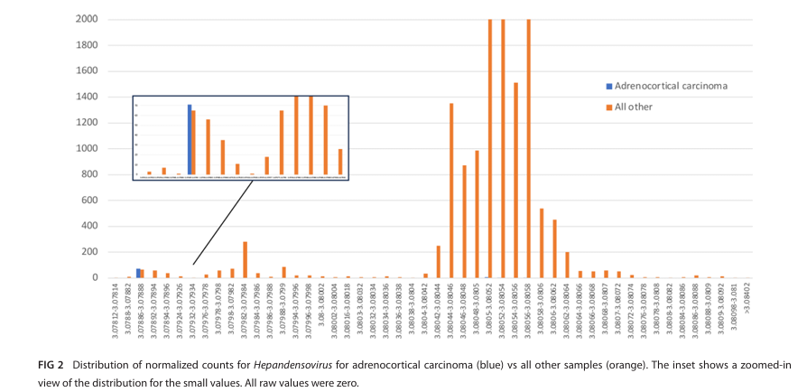
(2) The normalization completely confounds the machine learning results

Slide 14
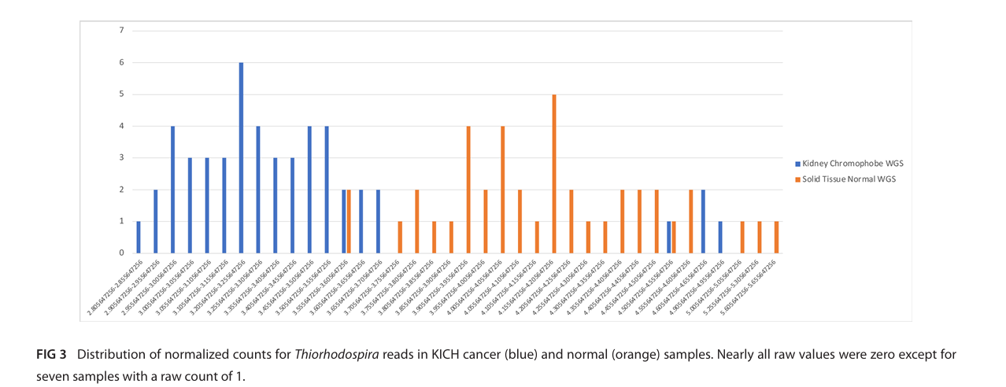
(2) The normalization completely confounds the machine learning results

Slide 15
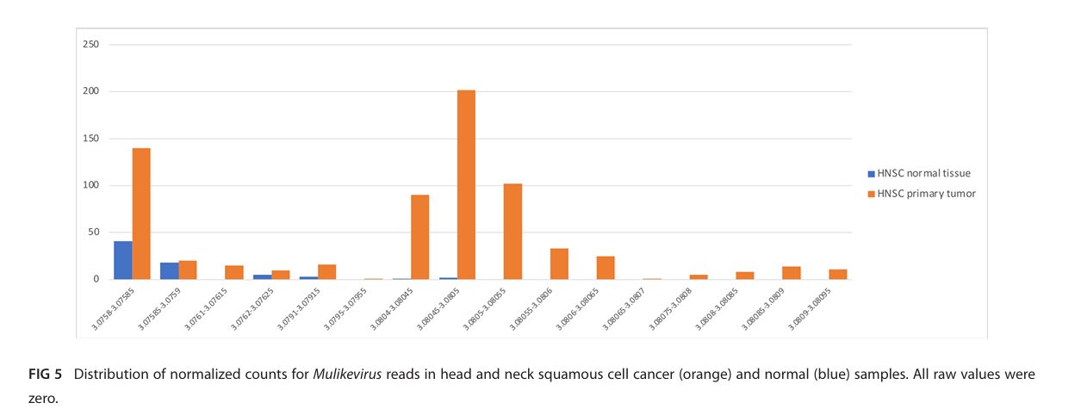
(2) The normalization completely confounds the machine learning results

Slide 16
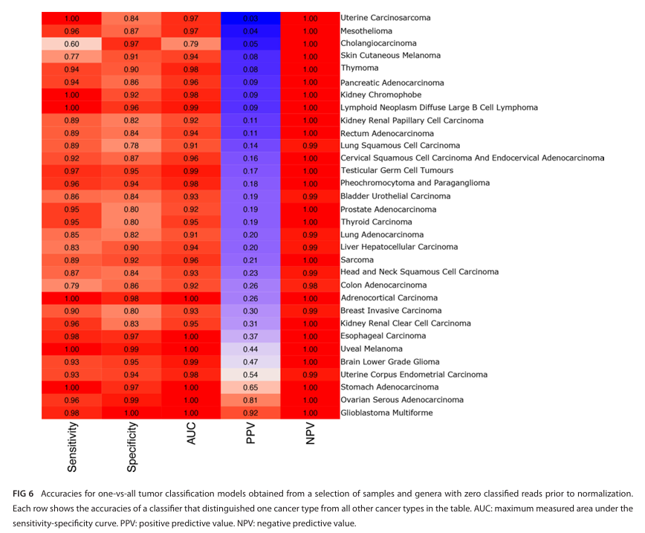
Prediction accuracies based on a spreadsheet that starts only with zeros!

Slide 17
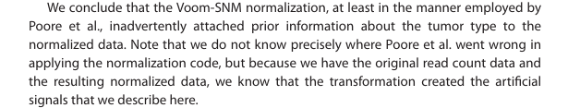
One limitation of Gihawi et al; it doesn’t explore why the batch correction failed so spectacularly.
Presumably, location or other metadata is correlated with disease and case/control, but this is not
explored in either paper…
It seems important which “prior information” was correlated with disease type

Slide 18


Slide 19
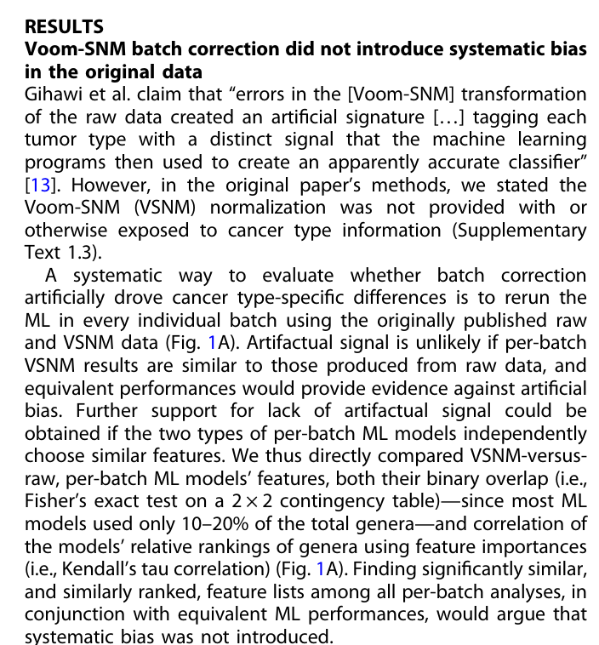
This is a terrible argument.
If disease is correlated with location or other “prior information”,
which it must be because of the all zero results,
both raw and batch correction algorithms
will produce near perfect results.
It is disappointing that this paper does not directly respond
to the “all zero” argument or explain which prior information
allowed that to happen.
In the absence of such an explanation, it just seems that these
authors are just making the same mistake again.

Slide 20
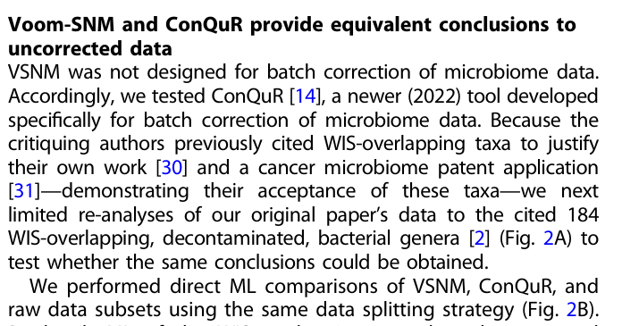
This is likewise a terrible argument.
The problem wasn’t just Voom, it
was linkage between information used
for the batch correction and cancer outcome.
Presumably all these batch correction algorithms
will just make the same mistake.

Slide 21
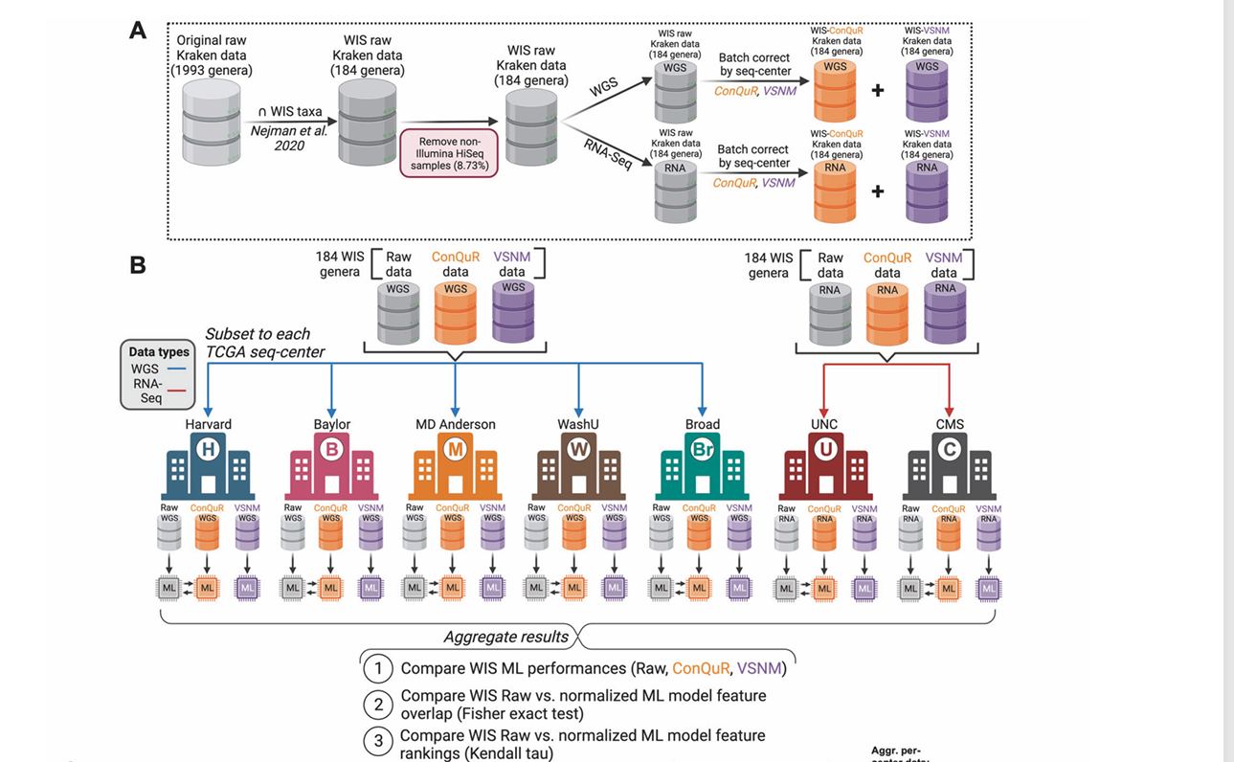
Because their pipeline aggregates results prior to ML, it doesn’t seem like it addresses the problem!

Slide 22
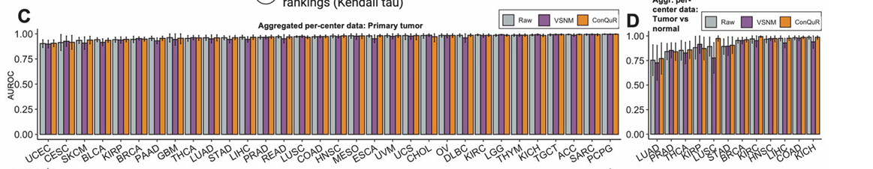
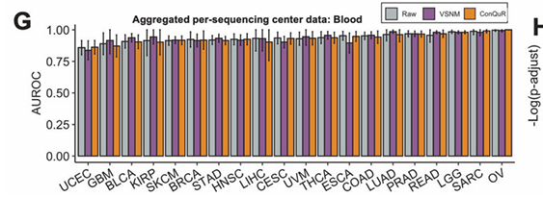
These essentially perfect results across all cancer types is just not biologically feasible.
The argument that it can’t be an artifact of normalization because the results are perfect
without normalization or with different normalization schemes appears naïve.

Slide 23
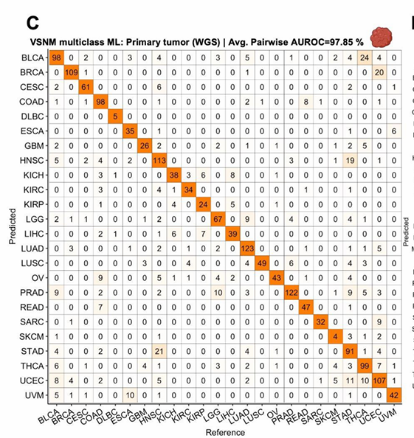
So take UCEC (which is Uterine Corpus Endometrial Cancer) according to Sup Fig. 1C. The confusion matrix says that there were 107 correctly identified samples, which seems pretty good. But in Supplementary Table S9, there are 110 samples from Harvard Medical School and 50 from Washington University. So are all 107 samples that were correctly identified from Havard?
This is supplementary Fig. 32C
Similar analysis for BRCA; there are 22 samples incorrectly predicted and 21 BRCA samples not from Wash U
So Knight lab is arguing that they are doing a useful thing of separating cancer types, but it seems like they are just doing a trivial thing of separating hospitals (which is just uncorrected batch effect being picked up from their machine learning algorithm)
The pairwise 97.85 accuracy seems highly over-stated (and not biologically feasible given error rates
In cancer diagnosis…)

Slide 24
But is there any evidence of microbial signal for cancer?
Yes.
Certain cancers clearly have microbial associations that are well supported in the literature.
H Pylori and stomach cancer.
E. Coli and CRC

Slide 25
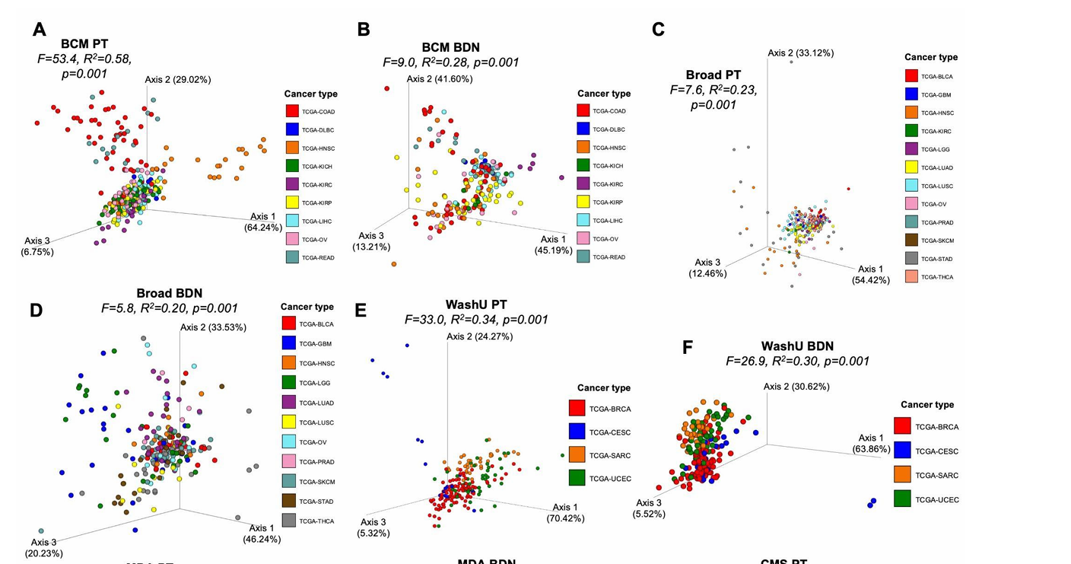
Supplementary Fig.28 shows PCoA’s by hospital shows some separation but not the perfect separation
Implied by the ML models… (and these are still separate studies within the hospitals)

Slide 26
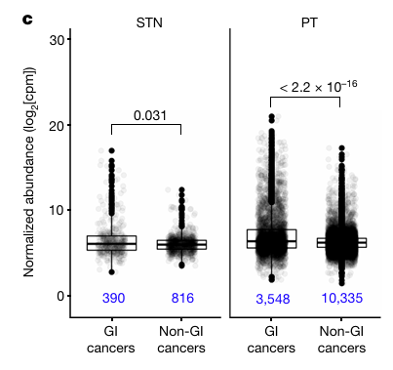
In the retracted paper, there are some convincing data…
This is fusobacterium in different cancer types.
These are significant differences.
But notice the effects size and overlap between the groups.
If you built a machine learning model from these data, the AUC would not be anywhere 0.99
So it is not that there is no evidence of microbial associations with cancer, but misuse of machine learning
algorithms made those associations appear much stronger than classical statistical analyses would suggest they really are

Slide 27
This is a problem of effect size.
There probably are microbes associated with cancer
But not perfect associations.
The complexity of machine learning algorithms interacts with pressure to publish and commercialize

